Slide 1
Machine Learning Model for Medical Image Segmentation
Nilesh
Ashish kumar

Slide 2
Agenda
Introduction
Software used
Result
conclusion

Slide 3
Introduction
Many diagnostic applications critically depend on the successful
localization of bone structure.
In this project, we have trained a machine learning model (a convolutional neural network called U-Net) to perform bone segmentation on 3D knee magnetic resonance imaging (MRI).
The goal is to develop a method that can
automatically detect the bone area from a knee MRI image.

Slide 4
In deep learning, a convolutional neural network (CNN, or ConvNet) is a class of deep neural networks, most commonly applied to analyzing visual imagery.

Slide 5
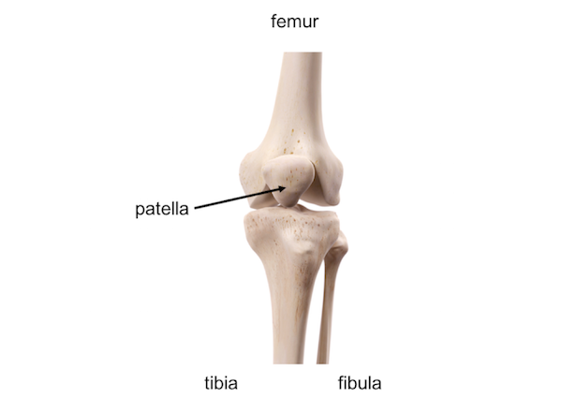
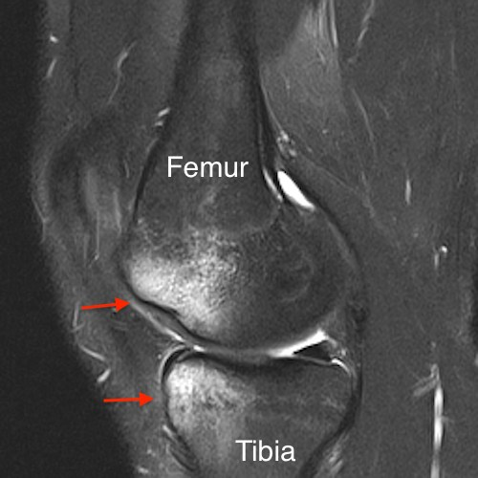

Slide 6
Software
Matlab by MathWorks
Google Colab

Slide 7
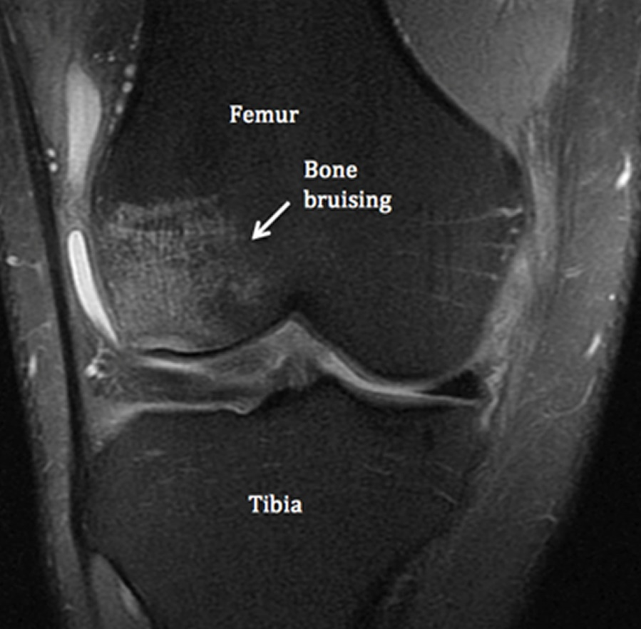

Slide 8
Dataset
45 cases of 3D knee Magnetic resonance images (MRI).
Each case with 160 images.

Slide 9
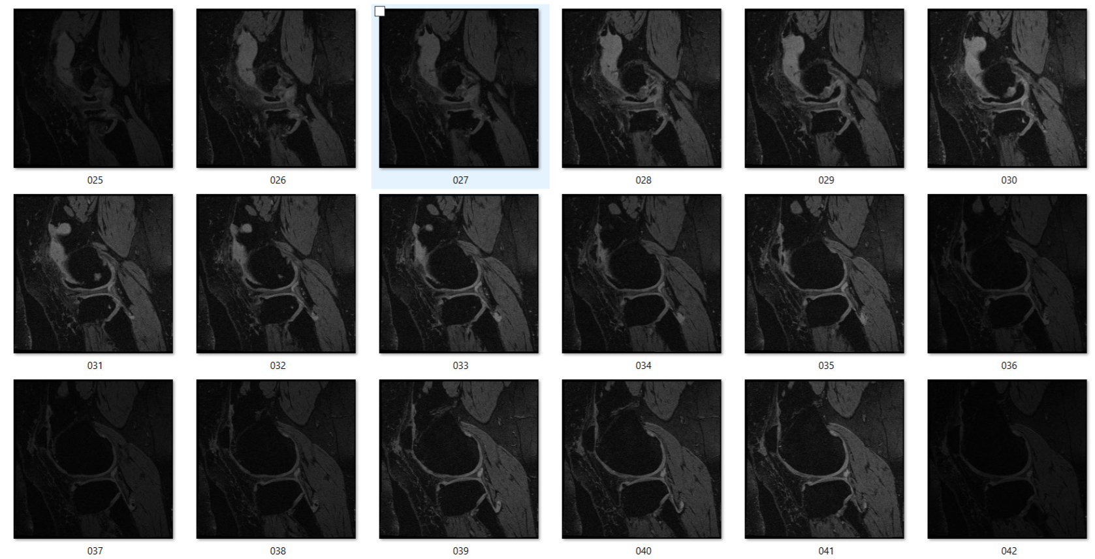
Data

Slide 10
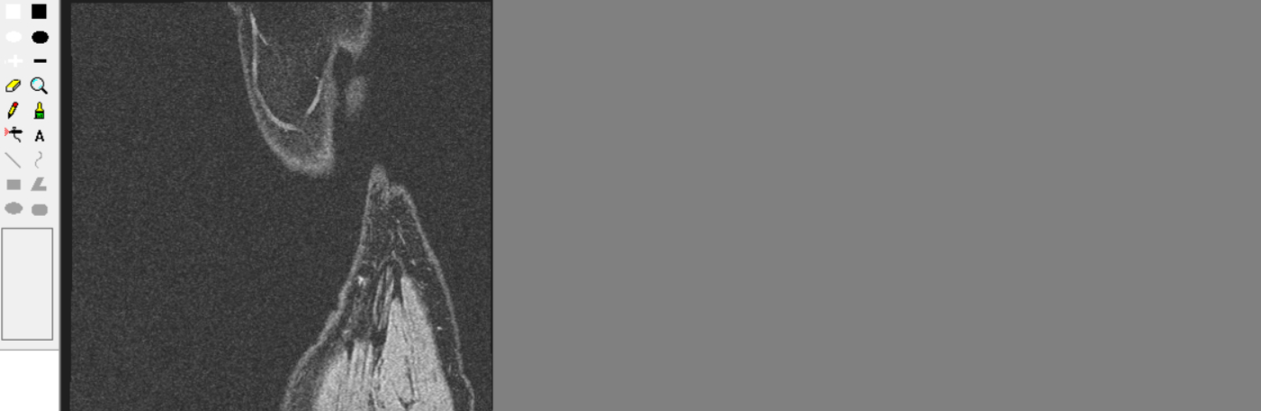
Data label

Slide 11
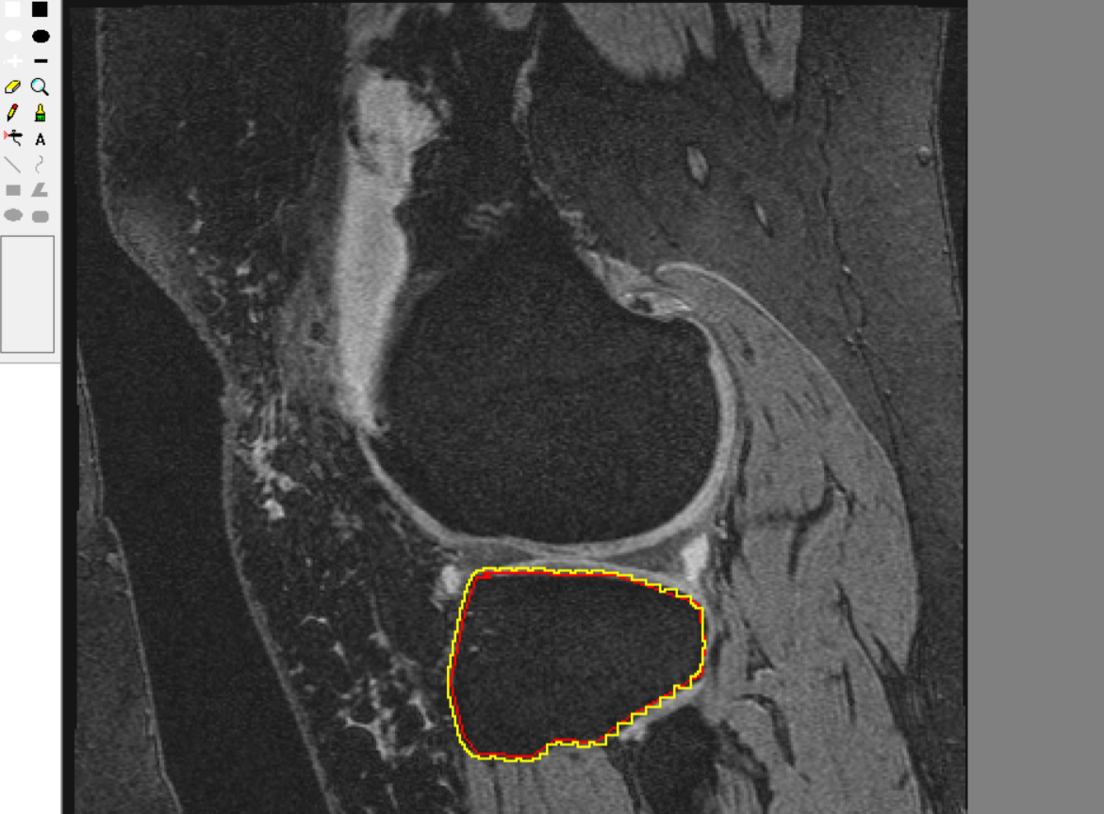

Slide 12
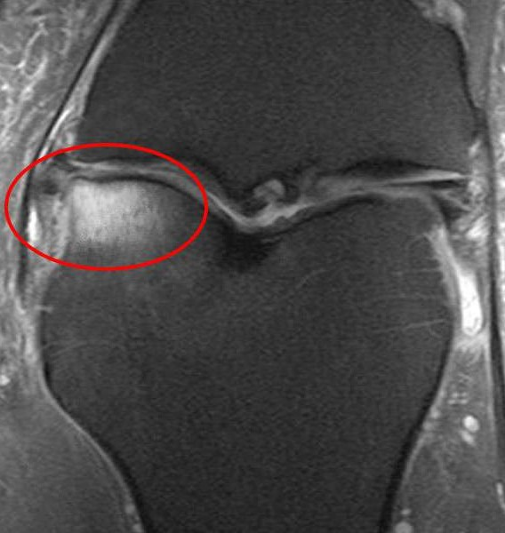

Slide 13
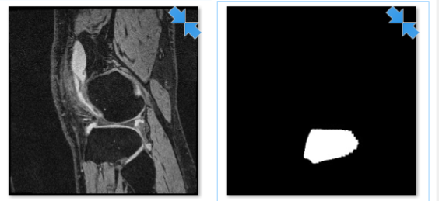
Data preparation

Slide 14
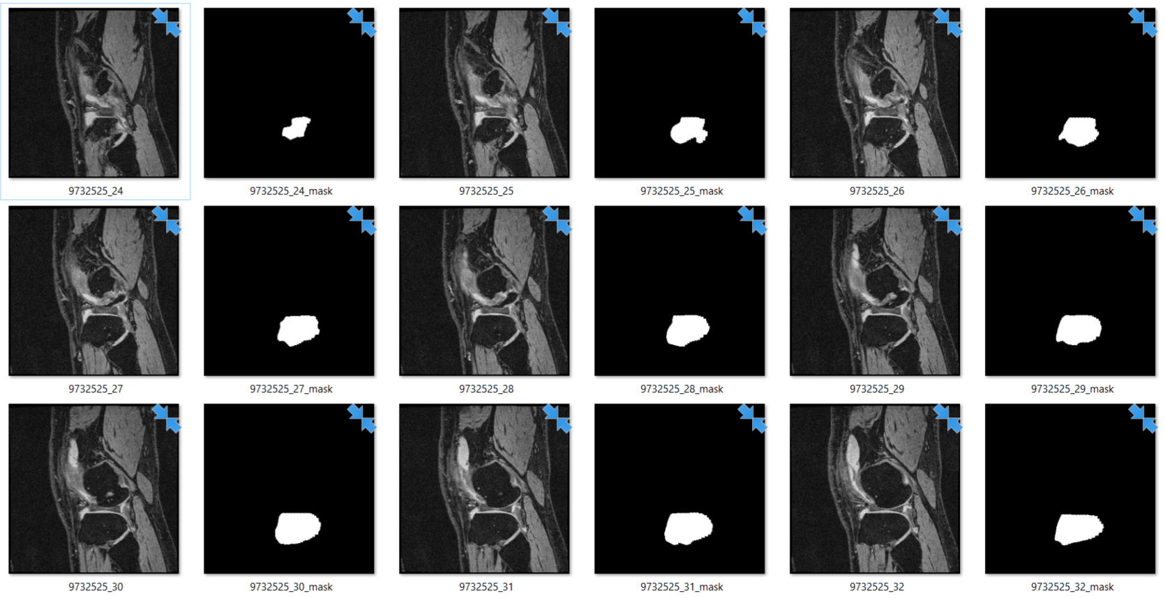

Slide 15
U-net
The U-Net is a convolutional neural network that was developed for biomedical image segmentation at the Computer Science Department of the University of Freiburg, Germany.[1] The network is based on the fully convolutional network [2] and its architecture was modified and extended to work with fewer training images and to yield more precise segmentations. Segmentation of a 512*512 image takes less than a second on a recent GPU.

Slide 16
Keras
Keras is an open-source neural-network library written in Python. It is capable of running on top of TensorFlow, Microsoft Cognitive Toolkit, Theano, or PlaidML.[1][2] Designed to enable fast experimentation with deep neural networks, it focuses on being user-friendly, modular, and extensible. It was developed as part of the research effort of project ONEIROS (Open-ended Neuro-Electronic Intelligent Robot Operating System),[3] and its primary author and maintainer is François Chollet, a Google engineer. Chollet also is the author of the XCeption deep neural network model[4].

Slide 17
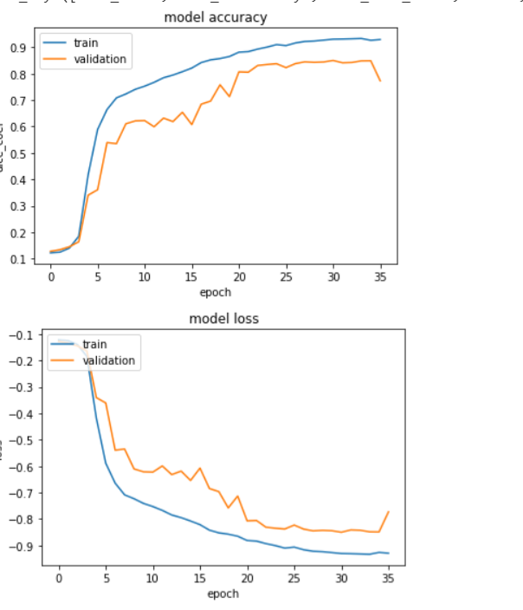
Result for 10 cases
Training : 95%
Validation:79%

Slide 18
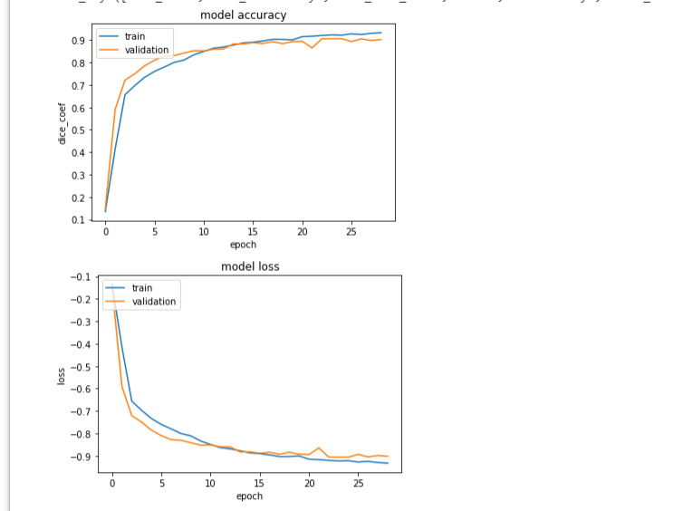
Result for 44 cases
Training : 95%
Validation:90%

Slide 19
Testing Result for 44 cases
loss: -0.883741628671
dice_coef: 0.88374163
similarity: 0.796089350
Testing Result for 10 cases
loss: -0.843198874540
dice_coef: 0.84319887
similarity: 0.73344115939

Slide 20
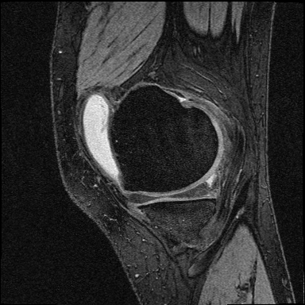
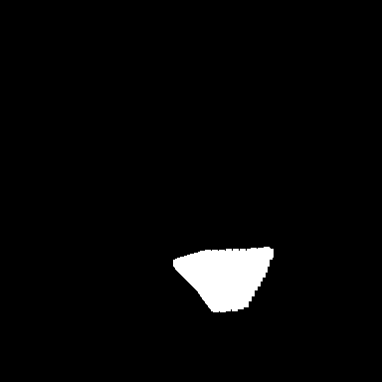
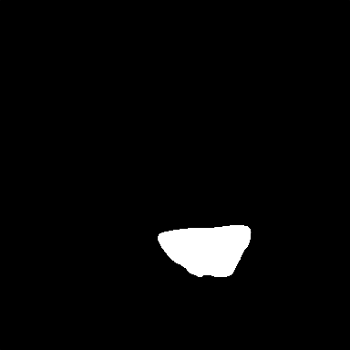
Data
Manual Segmentation
U-net Segmentation

Slide 21
Conclusion
By comparing result we can conclude that having more cases we can train model more accurately.

